Slide 1
Chapter 4 Process Abstraction
Chien-Chung Shen
CIS/UD
cshen@udel.edu

Slide 2
Crux of the Problem
Although there is only ONE physical CPU available, how can the OS provide the illusion of a nearly-endless supply of said CPUs?

Slide 3
Process
One fundamental abstractions that OS provides to users
Process is a running program
a program (executable, a.out) itself is a “lifeless” thing sitting on disk with instructions (and static data)
OS transforms a program into a running process
Need to run many processes at once
Problem: how to provide the illusion of many CPUs?
virtualize the CPU via “time” sharing
what is its “cost?”
performance
scheduling policy (high-level intelligence) & context switching mechanism (low-level machinery)
Notes:
$ gcc a.c
$ ./a.out

Slide 4
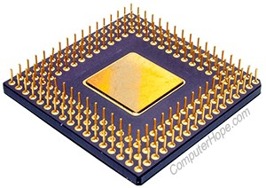
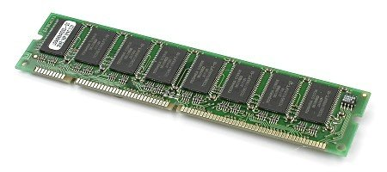
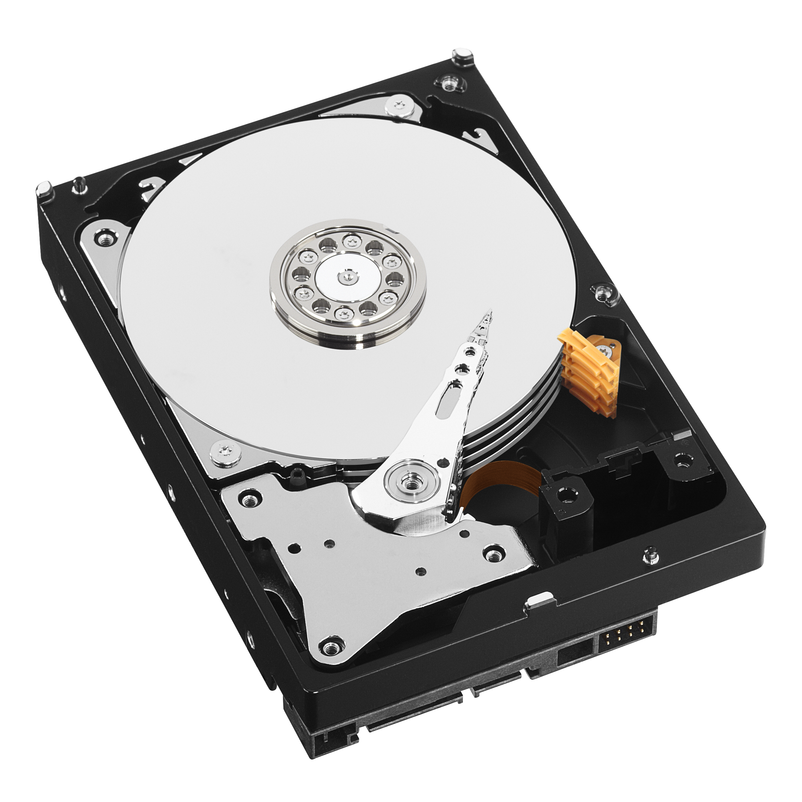
Process
Process: abstraction [provided by OS] of a running program
What constitute a process?
what pieces of a computer system will a process access or affect during the course of its execution?
an inventory of these pieces
Machine state (at any instance in time)
CPU registers (including PC/IP, SP, FP)
memory that the process can address: address space (including stack)
opened files

Slide 5
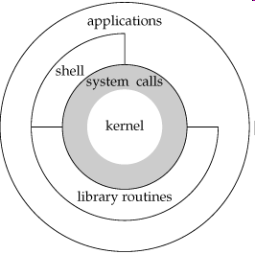
Process API
Interface (system calls) of an OS for processes
create – e.g., a process is created when an application icon is double-clicked
destroy
wait
miscellaneous control – suspend and resume
status

Slide 6
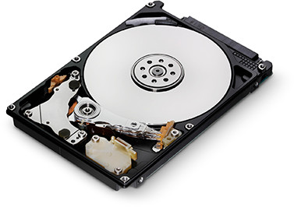
From Program to Process
program.h
program.c
a.out

Slide 7
Process Creation
How programs are transformed into processes?
load code and static data [executable] into memory (address space)
allocate and initialize (run-time) stack with argc & argv
initialize 3 default file descriptors (0, 1, and 2)
jump to main()- now OS transfers control of CPU to the newly-created process and program starts running
a.out

Slide 8
Process States (Life Cycle)
Running – using the CPU
Ready – someone else is using the CPU
Blocked – not ready to run until some other event takes place (e.g., initiated an I/O request to disk)

Slide 9
Tracing of Process States
CPU only
OS scheduler makes scheduling decisions
CPU and I/O

Slide 10
Data Structures of OS
Program = Algorithms + Data structures
OS is a program itself containing data structures
PCB (Process Control Block) of a process
register context
process state
where it is stored in memory
where its executable image resides on disk
which user asked it to execute
etc.
Lists (or queues) of PCBs
running queue (single CPU)
ready queue
I/O queues

Slide 11
Context & PCB in xv6 (proc.h)
register context (for context switching)
Process Control Block (PCB)
(Stevens & Rago’s Section 4.23)

Slide 12
PCB in (old) xv6 Kernel
register context (for context switching)
Process Control Block
(PCB)

Slide 13
Summary
Process: the most basic abstraction of OS
a running program
Low-level mechanisms needed to implement processes
Higher-level policies required to schedule processes in an intelligent way
Together, OS could virtualize the CPU

